Slide 1
The United States Opioid Epidemic:
Team Members:
Virendra Chauhan
Lin Fu
Rashmi Ray
Rene Lizarraga

Slide 2
Opioid Epidemic
The opioid epidemic is the rapid increase in the use of prescription and non-prescription opioid drugs in The United States.
Opioids are a diverse class of strong painkillers such as Oxycodone/Hydrocodone, Fentanyl/Tramadol, Methadone and recreational drug such as Heroine.
The availability of these substances, despite their high risk of addiction and overdose, have made them popular both as medical treatment and as recreational drug.
Due to their sedative effects on the part of brain, high dose causes respiratory failure and death.

Slide 3
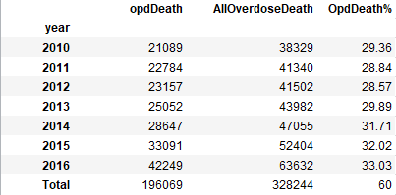
Opioid Death
Based on CDC Data we collected from 2010-2016.
328,244 Americans died from Drug over dose in 50 states.
196,069 Americans died from opioid related overdose.
Based on the data, 60% death contributed by opioid overdose.
In 2016 only, Opioids are responsible for 33% of overdose deaths which is 42,249 (opioids deaths) out of 63,632 (Total Overdose Deaths).

Slide 4
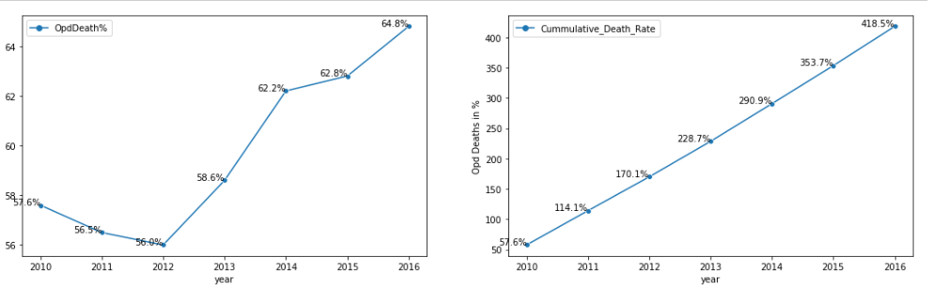
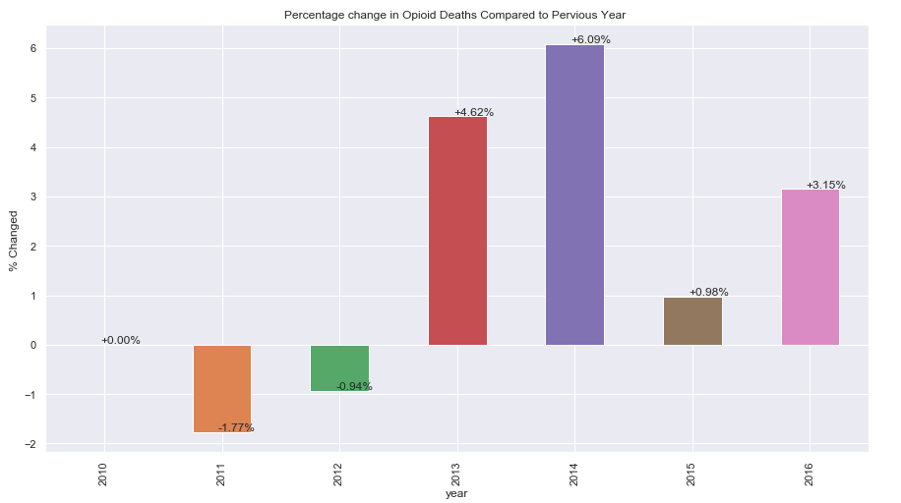
Opioid Deaths
The increase in opioid overdose deaths has been dramatic.
There is significant increase in death rate after 2012.
Since 2010, death rate has increased by 418%.
In 2016, death rate has increase from 62.8% to 64.8% ( +3.15%)

Slide 5
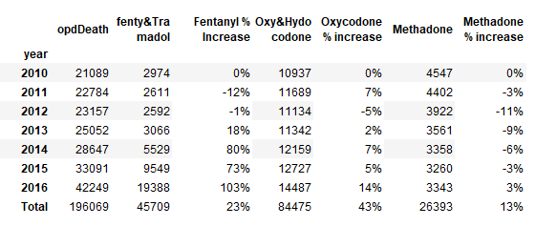
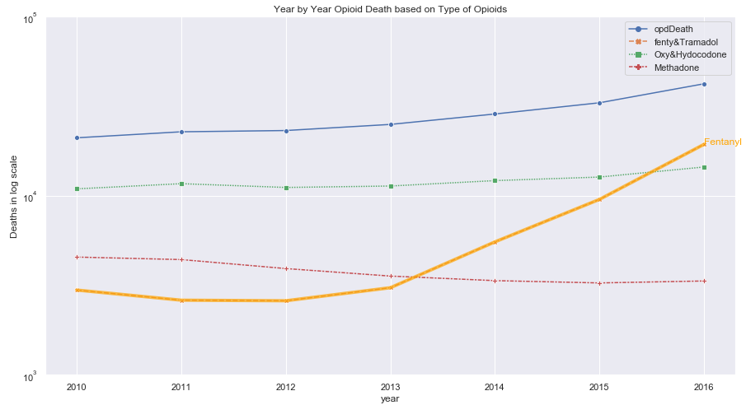
Cause of death by Drug Type (2010-2016)
Oxycodone : 43% death caused by overdose since 2016.
Fentanyl : 23% death caused by overdose since 2016. Overdose death on the rise since 2013, it increased to 73% in 2015 and 103% in 2016

Slide 6
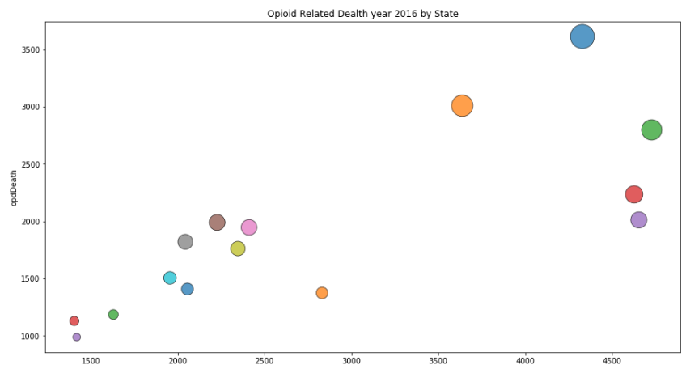
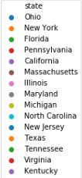
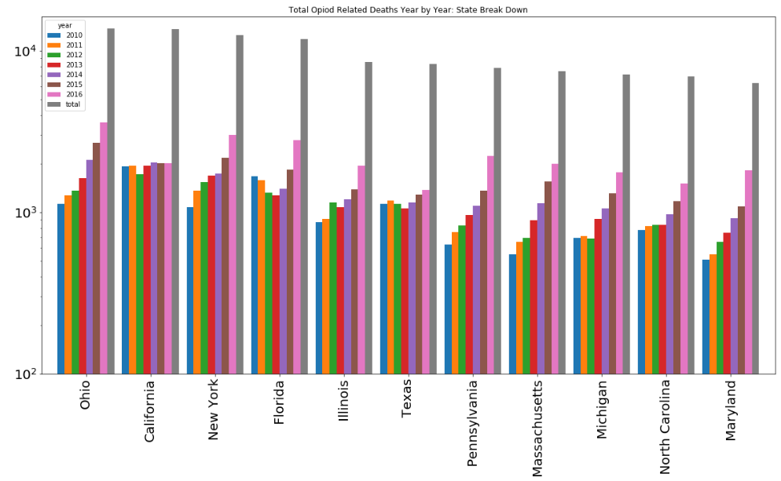
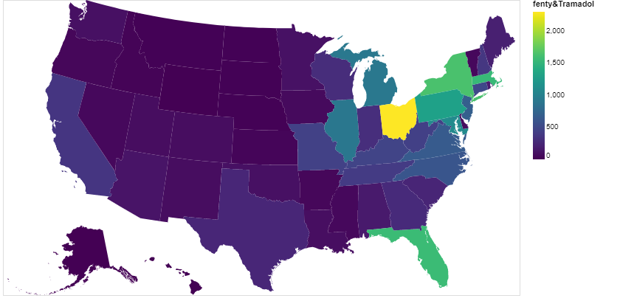
Opioid death State by State
2016, Top 15 States leading in Opioid Related deaths
The national rate of opioid overdose death has increase significantly from 6% to 418% from 2010-2016. The sharp increase has seen several states located in the East, Midwest, and Appalachian regions of the country, including Ohio, New York, Pennsylvania, Illinois, Florida and Virginia. However, one western state California shows stable rate in opioid death.
Synthetic Opioids:
The national rate of synthetic opioid overdose deaths increased to 256% from 2013 to 2016. This rapid rise is reflected in Ohio, Florida, New York, Illinois, Pennsylvania, Massachusetts, Michigan and Maryland

Slide 7
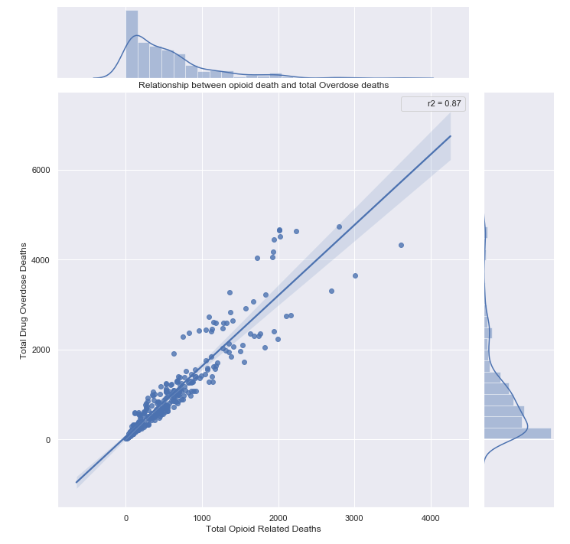
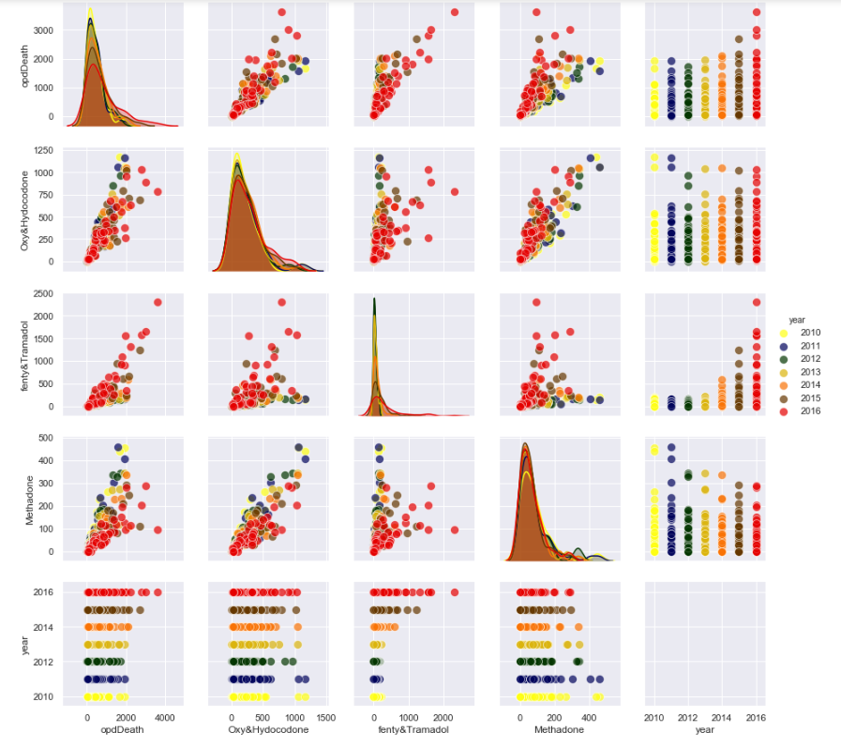
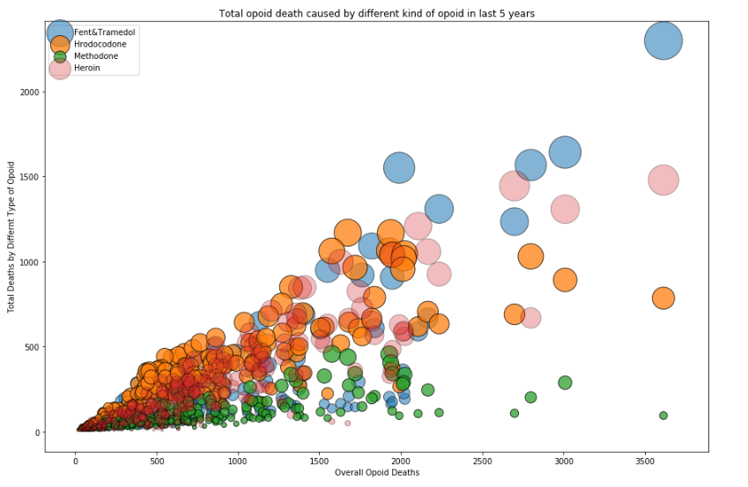
Is there any relationship between overdose death and Opioid deaths? R²=.85 (significant)

